Slide 1

Internet of Things Forensics
University of Nebraska at Omaha
Elisabeth Henderson, Ashley Leedom, Amber Makovicka, Ronald Ramirez, Nathan Wood
Notes:
@Ronald

Slide 2
Overview
Goals – Scope & Methodology
Project Findings & Outcomes
Demos
Conclusion
Notes:
Ronald

Slide 3
Goals - Scope & Methodology
Review
Review any existing standards and research relevant to IoT forensic and traditional digital forensics
Compare & Contrast
Compare and contrast IoT forensic techniques with those of traditional digital forensic standards
Identify
Identify major factors affecting slow growth in developing IoT forensic standards
Apply
Apply found recommendations for IoT forensics in hand-on experiments and analyze results
Provide
Provide educated recommendations for the future of IoT forensic standards
Notes:
Ronald

Slide 4
Project Findings & Outcomes
Notes:
Ron – transition like a boss
Milestone 3 outcomes

Slide 5
IoT Forensic Frameworks
Observed Trends in IoT Forensics:
Less developed than traditional digital forensics
Encompasses cloud, network, and device-level forensics
Not many traditional framework models
Proposes technological solutions to the digital investigation problem
Public Digital Ledgers
A Generic Digital Forensic Investigation Framework for Internet of Things (DFIF-IoT)
A generic framework that adapts principles from existing digital forensics frameworks
Provides a foundation for future improvement in the field
IoTDots
Notes:
Ashley

Slide 6
Notes:
Yo soy – that’s me

Slide 10
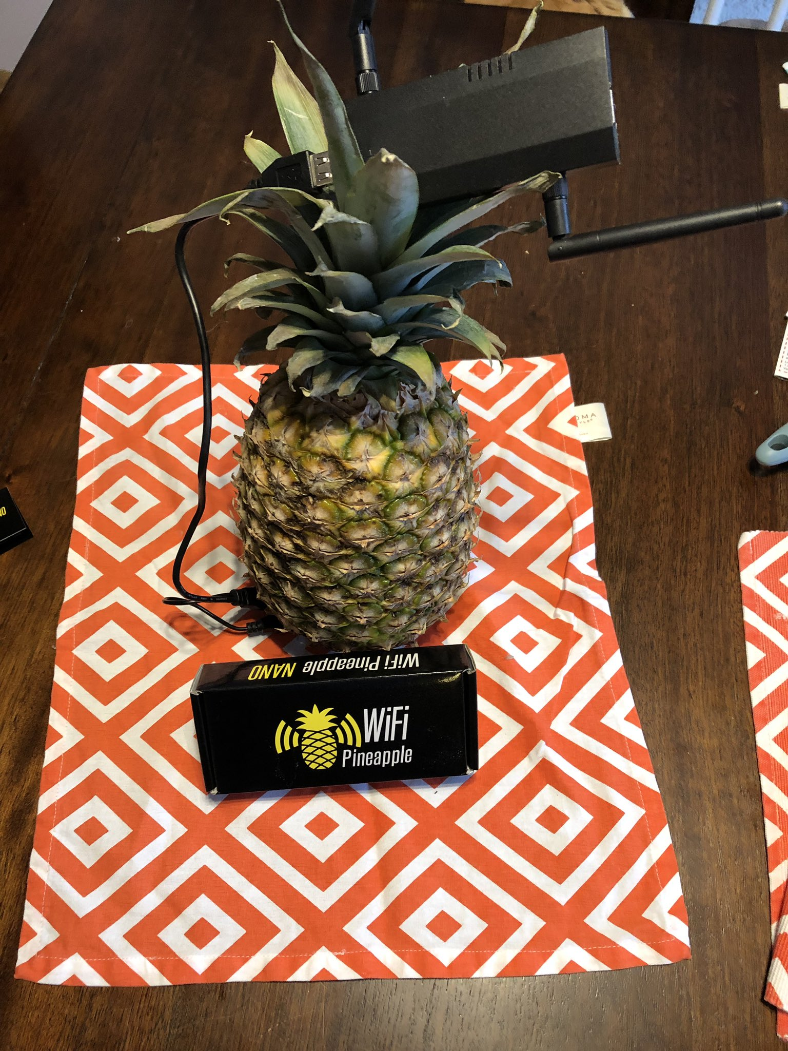
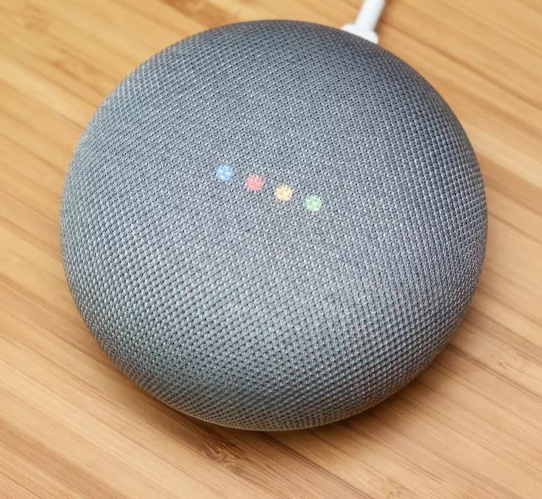
Google Home Mini & WIFI Pineapple
Private network for Google Home Mini
WiFi Pineapple provided isolated network and TCPDump capabilities
Wireshark used for live capture data and for analysis on TCPDump data
Notes:
Nate

Slide 11
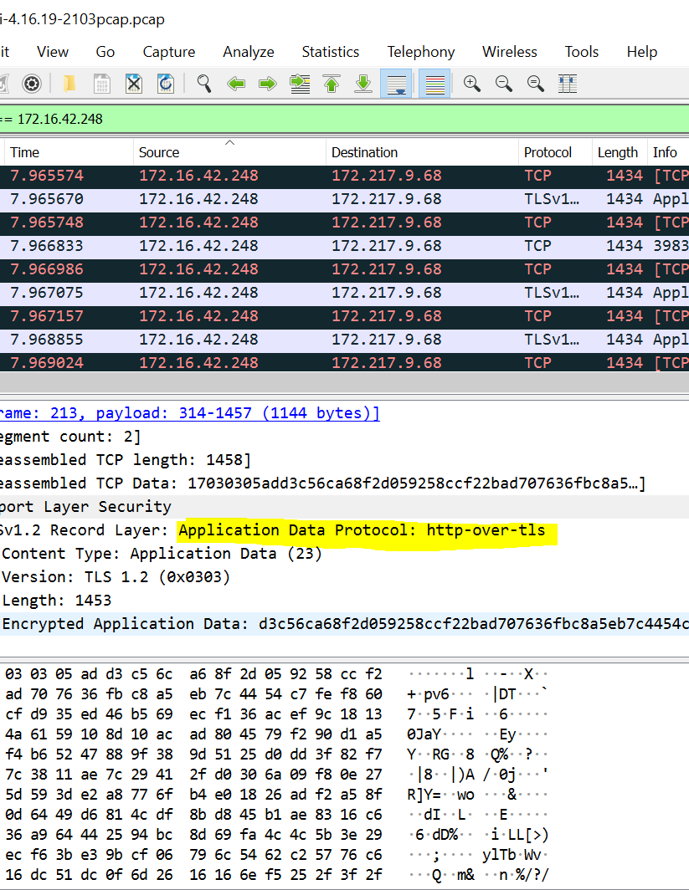
Google Home Mini & WIFI Pineapple
Application data is encrypted in TLS
Good for security, not good for network level investigation
Lots of DNS data even when the mini wasn’t active
Visible interaction when Google mini contacted servers for additional data

Slide 12
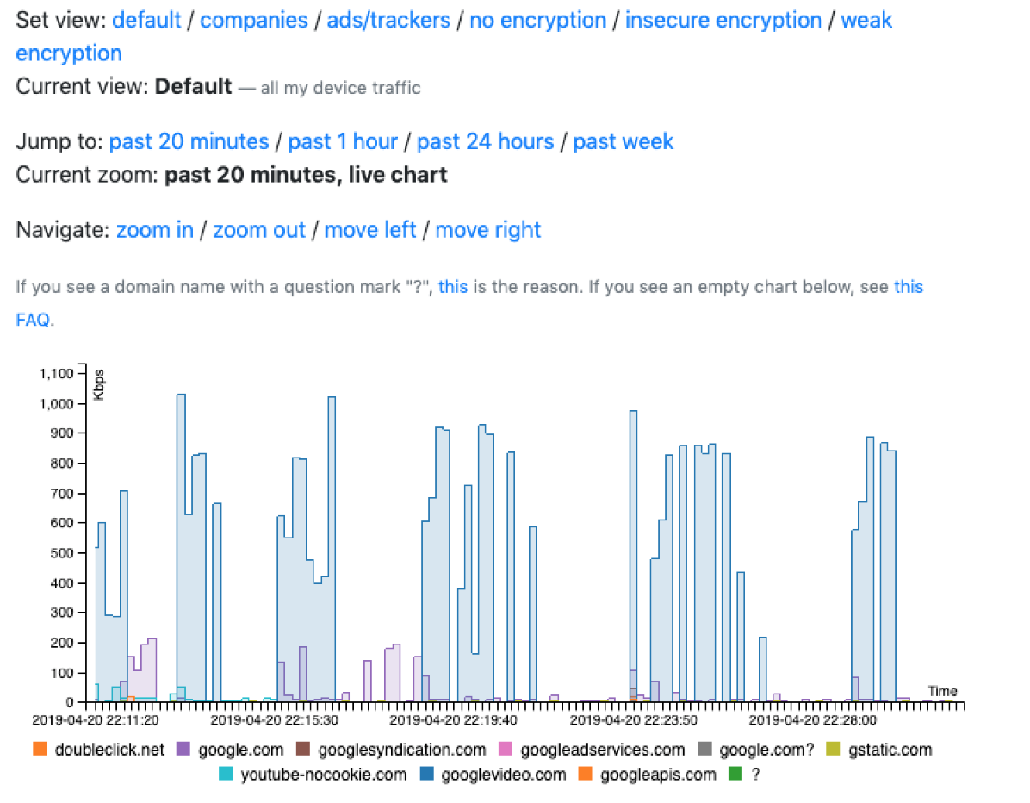
Princeton IoT Device Inspector
Monitors traffic
Wireshark visualization
Geared at research studies to gather data
Notes:
Ron

Slide 13
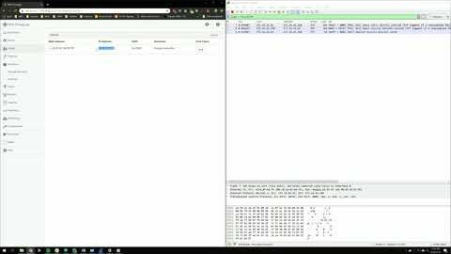
Google Home Mini Demo
Notes:
Nate

Slide 14
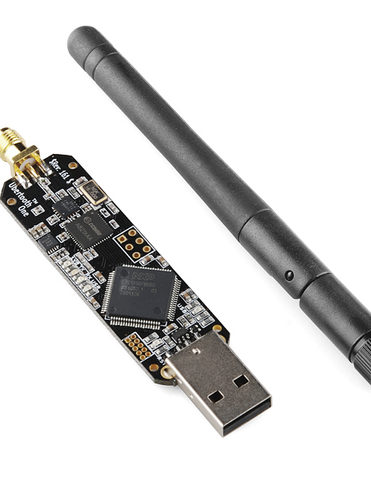
Bluetooth Sniffing
Ubertooth One
Open source Bluetooth project
Does not capture 100% of packets
Equipment
Ubuntu VM designed for Bluetooth sniffing
Android phone
MetaWear CPRO
Garmin Vivosmart HR+ wearable
Notes:
@Amber
Packet capture (PCAP) files generated were stored at ~/tmp/Capture folder.
Command: “sudo ubertooth-btle -f -c tmp/Capture/[filename].pcap”.
Btle is for Bluetooth Low Energy
-f to follow connections
-c for file save location

Slide 15

Ubertooth One
CONNECT_REQ packet
Connection request is made.
Wireshark holds MAC addresses of source and destination addresses
Endianness
Windows/Mac would be aa:bb:cc:dd:ee:ff
Ubuntu would be ff:ee:dd:cc:bb:aa

Slide 16

Ubertooth Demo

Slide 17
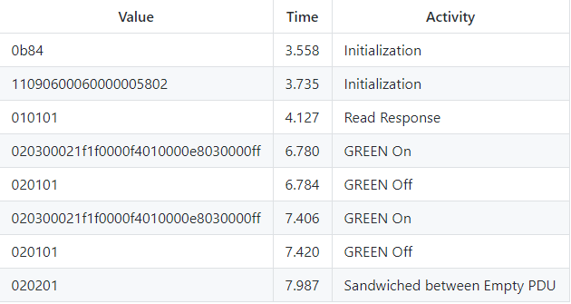
MetaWear Results
MetaWear CPRO uses Just WorksTM for Bluetooth connections
Three unique experiments executed
Observed initialization, read requests, read responses, LED turn-on requests, and LED turn-off requests
Clear-text packets difficult to read and can be time-consuming
Bluetooth traffic analysis not ideal starting point for IoT forensic analysis
Notes:
Three separate PCAP files were generated
Turn Red LED on and off 3x
Turn Green LED on and off 3x
Turn Blue LED on and off 3x

Slide 18
FTK Imager, Autopsy & XRY Set Up
Tools
FTK Imager Version 4.1.1.1
Autopsy Version 4.10.0
XRY Version 7.11
GPXSee Version 7.5 (i365, Qy 5.11.1)
fitdump.pl
Devices
Samsung Galaxy S3
Garmin Vivosmart HR+
Metawear CPRO
Google Home Mini
Notes:
@Elisabeth

Slide 19
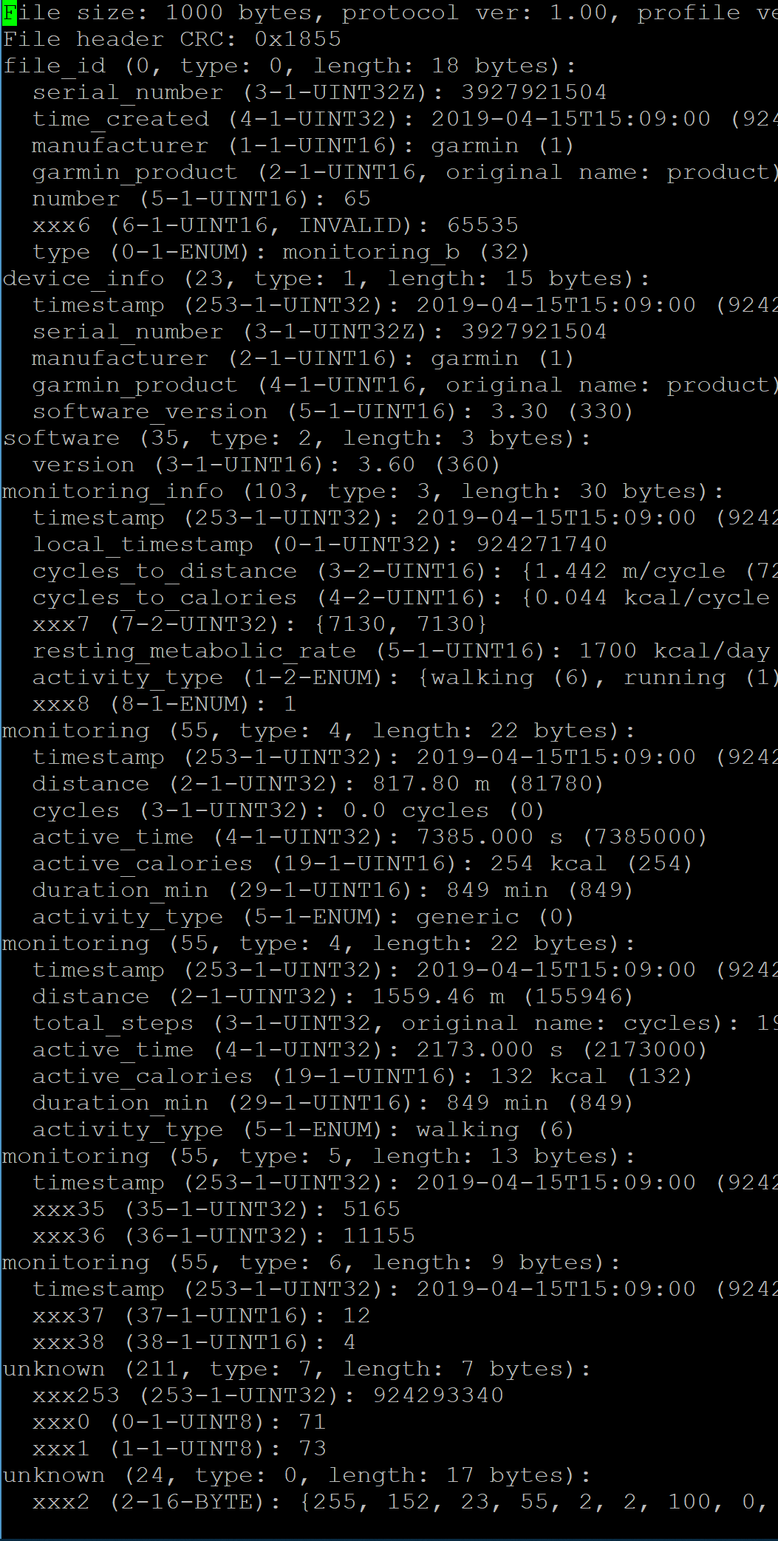
FTK Imager & Autopsy
Google Home Mini and Metawear
Garmin
GPXSee
fitdump.pl

Slide 20
GPXSee Demo
https://use.vg/ql7cdf

Slide 21
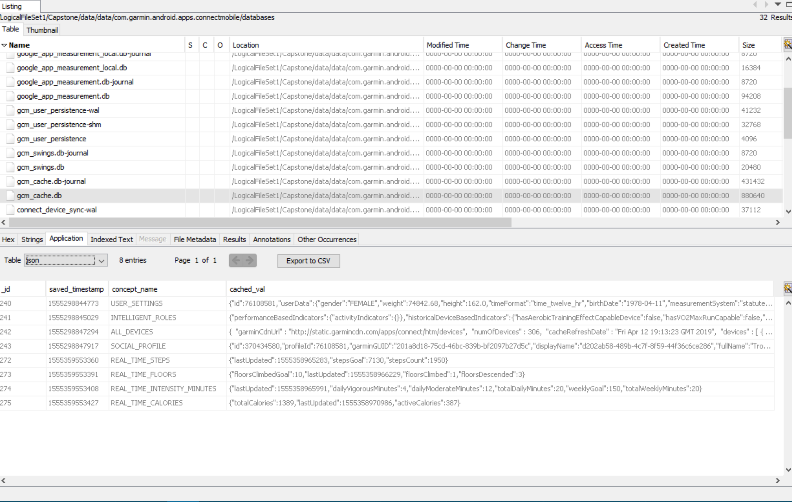
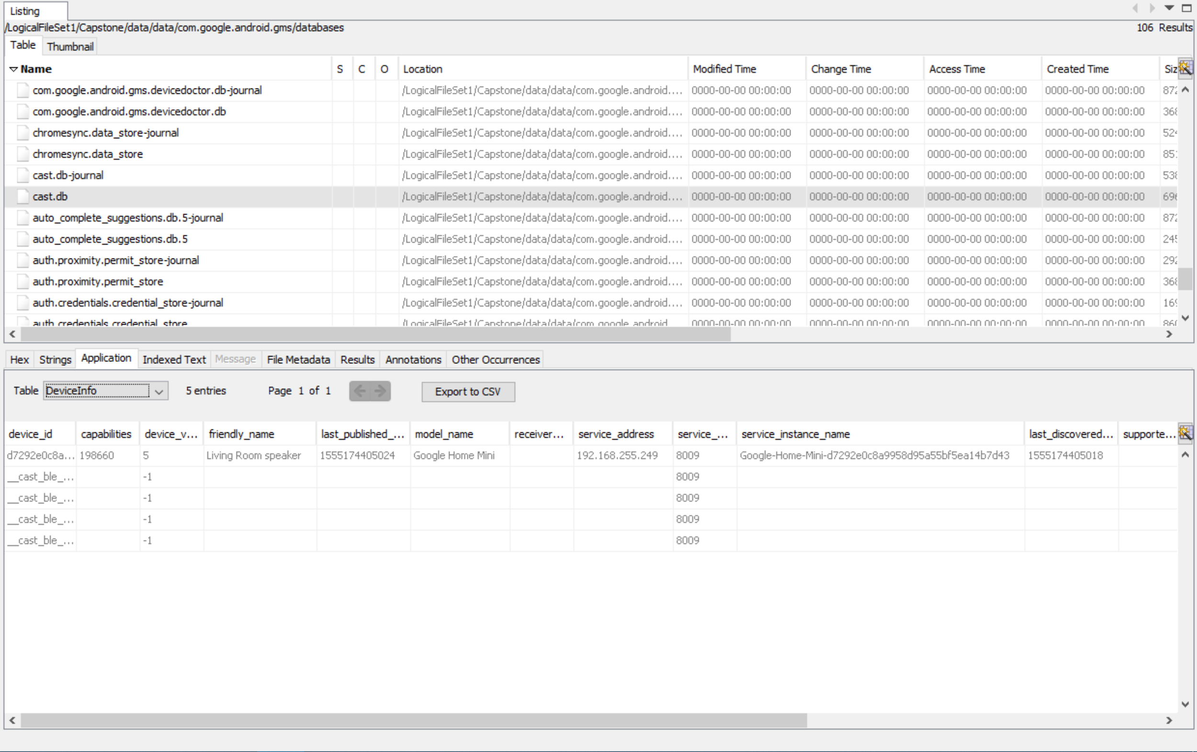
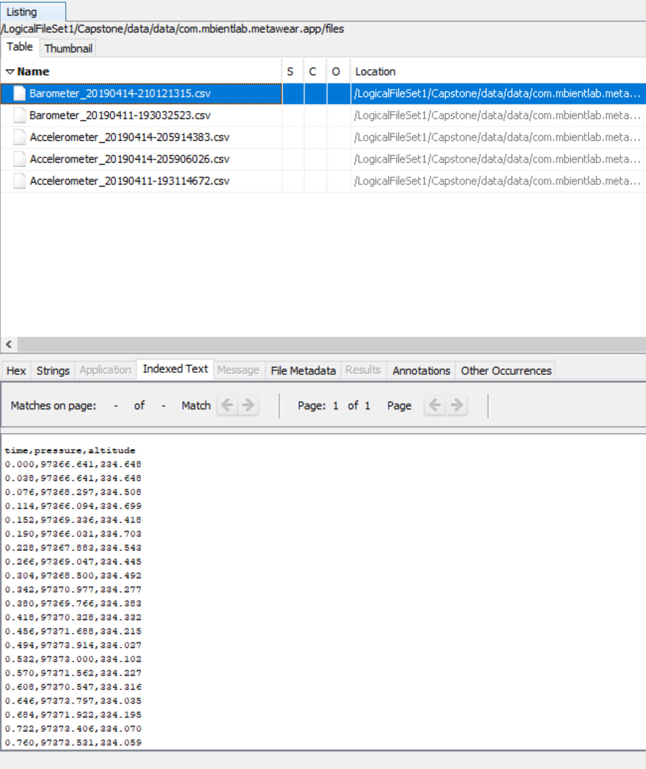
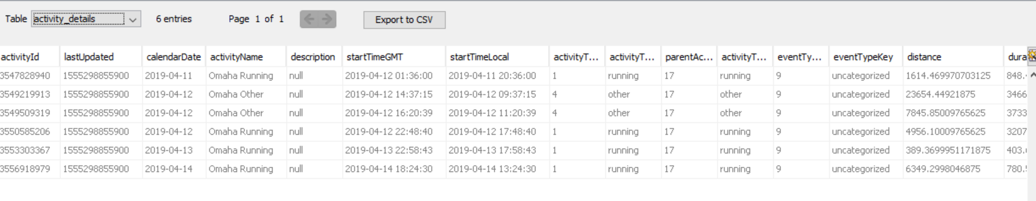
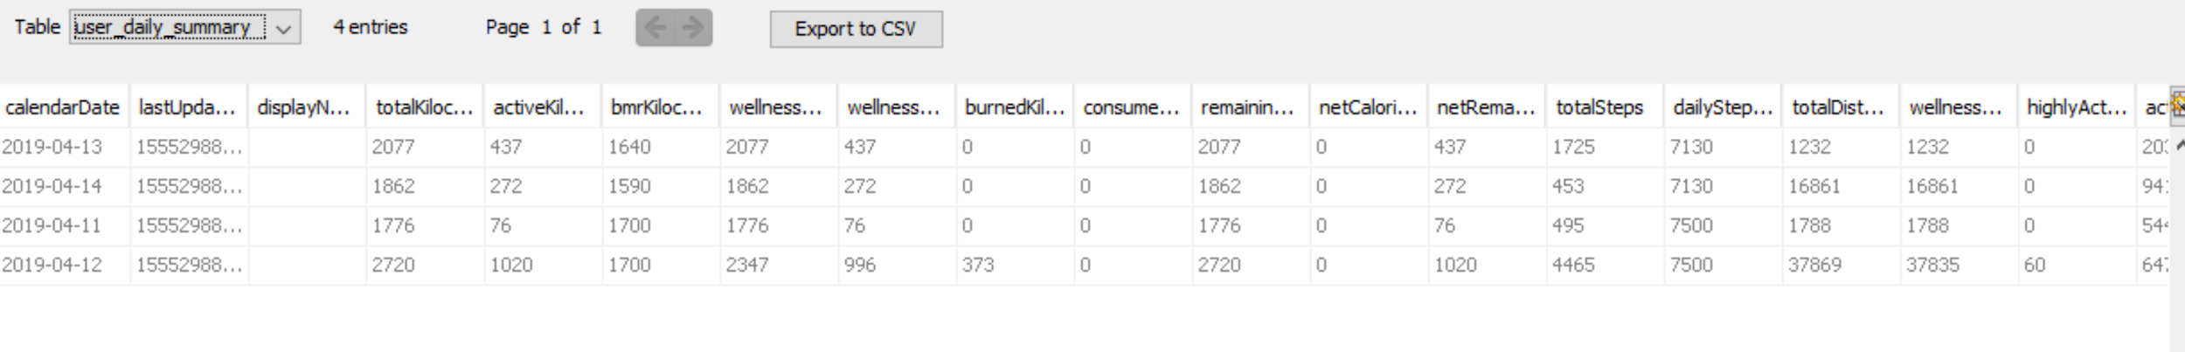
XRY and Autopsy
Google Home Mini
Connection
Events
Metawear
Unsaved Files
Garmin
User profile data
User daily summary
User workout information

Slide 22
Notes:
Just wtf

Slide 23

Conclusion & Recommendations
IoT forensics is a combination of other forensic methods
Cloud, Mobile, Network
Focus more on implementing technical solutions rather than implementing frameworks
IoT devices & manufacturers should standardize equipment and data storage methods
Notes:
@Ash

